Slide 2
Problem Solving and Programming
Dr Solomon Amos
ac8880@coventry.ac.uk
14th January, 2019

Slide 3
Week 1 Learning Objectives
Recognise the essential course documentation.
Pseudocode.
Boolean algebra and logic.
Programming language types and paradigms.
Introduction to Python.
Programming fundamentals.
Introduction to algorithms.

Slide 4
Day 1 Learning Objectives
Understand the following course documents:
Module Information Descriptor (MID)
Scheme of Work (Sow)
Essential & Recommended Reading List.
1st Assignment Brief
CU-Harvard referencing guides
Boolean algebra and logic.

Slide 5
Understand the course documents
Module Information Descriptor (MID)
Intended Module Learning Outcomes (MLOs)
Indicative Content
Reading List (Essential & Recommended)
Scheme of Work (SOW)
Subject matter taught for each session.
Assignment Brief (including template)
Requirement specifications for your assignment.

Slide 6
What ultimately matters in this course is not so much where you end up relative to your classmates but where you, in Week 6, end up relative to yourself in Week 1

Slide 7
Problem Solving
Notes:
The course itself ultimately is not about programming per se that is indeed a tool that we’ll use. It’s all about problem solving that is really interesting and that is what CS is generally. Whether you are interested in software development, graphics, AI, ML, hardware, theory etc. What is really interesting about CS is that its not an end to itself, its what empowers you to go do more interesting and powerful things in any field.

Slide 8
Problem Solving
Inputs
Outputs
Notes:
The course itself ultimately is not about programming per se, that is indeed a tool that we’ll use. It’s all about problem solving that is really interesting and that is what CS is generally. Whether you are interested in software development, cyber security, networking, graphics design, AI, ML, hardware, theory etc. What is really interesting about CS is that its not an end to itself, its what empowers you to go do more interesting and powerful things in any field.

Slide 9
ASCII
A B C D E F G H I ...
65 66 67 68 69 70 71 72 73 ...
Notes:
The course itself ultimately is not about programming per se, that is indeed a tool that we’ll use. It’s all about problem solving that is really interesting and that is what CS is generally. Whether you are interested in software development, cyber security, networking, graphics design, AI, ML, hardware, theory etc. What is really interesting about CS is that its not an end to itself, its what empowers you to go do more interesting and powerful things in any field.

Slide 10
ASCII
72 73 33
Notes:
The course itself ultimately is not about programming per se, that is indeed a tool that we’ll use. It’s all about problem solving that is really interesting and that is what CS is generally. Whether you are interested in software development, cyber security, networking, graphics design, AI, ML, hardware, theory etc. What is really interesting about CS is that its not an end to itself, its what empowers you to go do more interesting and powerful things in any field.

Slide 11
ASCII
H I !
72 73 33
1001000 1001001 100001
Notes:
The course itself ultimately is not about programming per se, that is indeed a tool that we’ll use. It’s all about problem solving that is really interesting and that is what CS is generally. Whether you are interested in software development, cyber security, networking, graphics design, AI, ML, hardware, theory etc. What is really interesting about CS is that its not an end to itself, its what empowers you to go do more interesting and powerful things in any field.

Slide 12
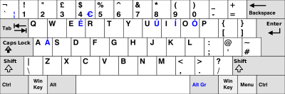
Abstraction
Notes:
The course itself ultimately is not about programming per se, that is indeed a tool that we’ll use. It’s all about problem solving that is really interesting and that is what CS is generally. Whether you are interested in software development, cyber security, networking, graphics design, AI, ML, hardware, theory etc. What is really interesting about CS is that its not an end to itself, its what empowers you to go do more interesting and powerful things in any field.

Slide 13

Abstraction
128514
11111011000000010
Unicode and UTF-8
Notes:
The course itself ultimately is not about programming per se, that is indeed a tool that we’ll use. It’s all about problem solving that is really interesting and that is what CS is generally. Whether you are interested in software development, cyber security, networking, graphics design, AI, ML, hardware, theory etc. What is really interesting about CS is that its not an end to itself, its what empowers you to go do more interesting and powerful things in any field.

Slide 14
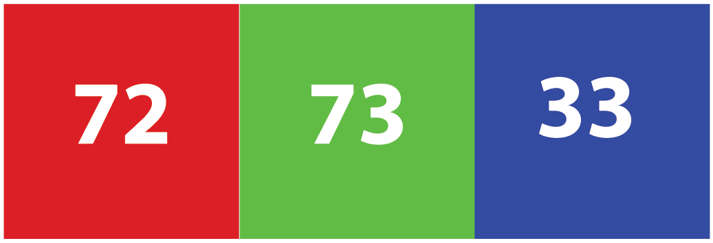

RGB
=
Notes:
The course itself ultimately is not about programming per se, that is indeed a tool that we’ll use. It’s all about problem solving that is really interesting and that is what CS is generally. Whether you are interested in software development, cyber security, networking, graphics design, AI, ML, hardware, theory etc. What is really interesting about CS is that its not an end to itself, its what empowers you to go do more interesting and powerful things in any field.

Slide 15
Problem Solving
Inputs
Outputs
Notes:
The course itself ultimately is not about programming per se, that is indeed a tool that we’ll use. It’s all about problem solving that is really interesting and that is what CS is generally. Whether you are interested in software development, cyber security, networking, graphics design, AI, ML, hardware, theory etc. What is really interesting about CS is that its not an end to itself, its what empowers you to go do more interesting and powerful things in any field.

Slide 16
Problem Solving
ALGORITHMS
Inputs
Outputs
Notes:
Algorithms – Step by step instructions for solving some problems

Slide 17
Pseudocode
0 pick up phone book
1 open to middle of phone book
2 look at names
3 if Smith is among names
4 call Mike
5 else if Smith is earlier in book
6 open to middle of left half of book
7 go back to step 2
8 else if Smith is later in book
9 open to middle of right half of book
10 go back to step 2
11 else
12 quit
0 pick up phone book
1 open to middle of phone book
2 look at names
3 if Smith is among names
4 call Mike
5 else if Smith is earlier in book
6 open to middle of left half of book
7 go back to step 2
8 else if Smith is later in book
9 open to middle of right half of book
10 go back to step 2
11 else
12 quit
Notes:
Algorithms – Step by step instructions for solving some problems

Slide 18
Pseudocode
0 pick up phone book
1 open to middle of phone book
2 look at names
3 if Smith is among names
4 call Mike
5 else if Smith is earlier in book
6 open to middle of left half of book
7 go back to step 2
8 else if Smith is later in book
9 open to middle of right half of book
10 go back to step 2
11 else
12 quit
0 pick up phone book
1 open to middle of phone book
2 look at names
3 if Smith is among names
4 call Mike
5 else if Smith is earlier in book
6 open to middle of left half of book
7 go back to step 2
8 else if Smith is later in book
9 open to middle of right half of book
10 go back to step 2
11 else
12 quit
Notes:
Algorithms – Step by step instructions for solving some problems

Slide 19
Pseudocode
0 pick up phone book
1 open to middle of phone book
2 look at names
3 if Smith is among names
4 call Mike
5 else if Smith is earlier in book
6 open to middle of left half of book
7 go back to step 2
8 else if Smith is later in book
9 open to middle of right half of book
10 go back to step 2
11 else
12 quit
Notes:
Algorithms – Step by step instructions for solving some problems

Slide 20
Program
We can write programs with the building blocks we just discovered:
Functions
Conditions
Boolean expressions
Loops
Variables
Threads
Events …
Notes:
Algorithms – Step by step instructions for solving some problems

Slide 21
Pseudo Code Explained
Pseudo Code
Describes a programming algorithm using a sequence of programing language independent statements.
Example (Windows Login)
Prompt user to enter login credentials (Username & Password)
Verify user’s credentials.
If user’s credentials are valid display the Windows Desktop else display “Invalid login credentials” message.

Slide 22
Learning Activity 1
Learners to:
Work in pairs to create pseudo code for making a cup of tea/coffee. (20 mins)
Review to determine if there are any other alternative ways they could modify their pseudo code to accomplish the same goal. (20 mins)
Tutor to:
Provide one-to-one guidance and support to learners.

Slide 23



Logic Gates
A logic gate is an elementary building block of a digital circuit, where every terminal is in one of the two binary conditions low (0) or high (1), represented by different voltage levels.
A Logic gate performs a logical operation on one or more binary inputs and produces a single binary output.
0
1
0
0
1
1
0
1
AND Gate
NOT Gate
OR Gate

Slide 24
Boolean algebra and logic
Boolean algebra is a system of mathematics based on logic that has its own set of rules or laws which are used to define and reduce Boolean expressions.
Indispensable in the design of computer chips and integrated circuits.
Fundamental in the understanding and design of computing programs.

Slide 25
Boolean algebra and logic
When dealing with Boolean expressions, we use bit values which represent a logic level “1” or a logic level “0” respectively.
An expression can have an infinite number of variables all labelled individually to represent inputs to the expression.
For example, variables X, Y, Z etc, giving us a logical expression of X + Y = Z, but each variable can ONLY be a 0 or a 1.

Slide 26
Basic Operations
There are three types of operations.
AND
Denoted as ∧, for example X ∧ Y. AND can also be denoted using a dot . between variables, as an example X.Y. Alternatively the operator can also be emitted entirely, such as XY.
OR
Denoted as ∨, for example X ∨ Y. OR can also be denoted using a plus symbol +, as an example X + Y.
NOT
Denoted as ¬, for example ¬A.

Slide 27
Boolean Laws
There are six types of Boolean Laws.
Commutative law
Associative law
Distributive law
AND law
OR law
INVERSION law

Slide 28
Boolean Laws
The Commutative law states that changing the sequence of the variables does not have any effect on the output of a logic circuit.
Any binary operation which satisfies the following expression is referred to as commutative operation:
(i.) A.B = B.A
(ii.) A+B = B+A

Slide 29
Boolean Laws
The Associative law states that the order in which the logic operations are performed is irrelevant as their effect is the same.
For example:
(i.) (A.B).C = A.(B.C)
(ii.) (A+B)+C = A+(B+C)

Slide 30
Boolean Laws
The Distributive law states that multiplying a number by a group of numbers added together is the same as doing each multiplication separately.
For example:
A.(B+C) = A.B + A.C

Slide 31
Boolean Laws
The AND law uses the AND operation.
For example:
(i.) A.0 = 0
(ii.) A.1 = A
(iii.) A.A = A
(iv.) A.¬A = 0

Slide 32
Boolean Laws
The OR law uses the OR operation.
For example:
(i.) A+0 = A
(ii.) A+1 = 1
(iii.) A+A = A
(iv.) A+¬A = 1

Slide 33
Boolean Laws
The INVERSION law uses the NOT operation. The inversion law states that double inversion of a variable results in the original variable itself.
For example:
¬¬A = A

Slide 34
Truth Tables
A truth table is a mathematical table used in logic—specifically in connection with Boolean algebra, boolean functions, and propositional calculus—which sets out the functional values of logical expressions on each of their functional arguments, that is, for each combination of values taken by their logical variables (Enderton, 2001)
Enderton, H. (2001). A Mathematical Introduction to Logic, second edition, New York: Harcourt Academic Press.

Slide 35
Truth Tables
Basic logical operators: The truth table below defines the AND and OR functions, where T denotes True and F denotes False.
Referring to the table, the Boolean statement X.Y evaluates as True if X is True and Y is True.
If either X and/or Y is False, then the statement X.Y evaluates to False.
P | Q | P.Q | P+Q
T | T | T | T
T | F | F | T
F | T | F | T
F | F | F | F

